Slide 1
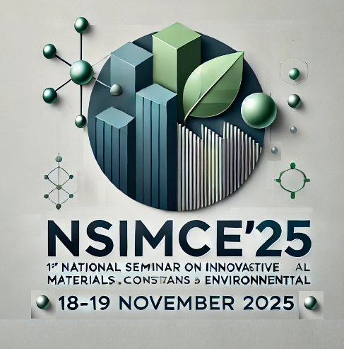
LOGO 2
1st National Seminar on Innovative Materials, Construction and Environmental (NSIMCE’25) : 18 – 19 November 2025
ID: .............
Title of the communication
Author¹, Author², Author³
¹ Affiliation Author 1
² Affiliation Author 2
³ Affiliation Author 3
The following describes example directions for a poster. The following describes example directions for a poster.
The following describes example directions for a poster. The following describes example directions for a poster.
The following describes example directions for a poster. The following describes example directions for a poster.
The following describes example directions for a poster.
Abstract
The following describes example directions for a poster. The following describes example directions for a poster. The following describes example directions for a poster. The following describes example directions for a poster. The following describes example directions for a poster. The following describes example directions for a poster. The following describes example directions for a poster. The following describes example directions for a poster. The following describes example directions for a poster. The following describes example directions for a poster.
The following describes example directions for a poster. The following describes example directions for a poster. The following describes example directions for a poster. The following describes example directions for a poster. The following describes example directions for a poster. The following describes example directions for a poster.
Methods
Results
The following describes example directions for a poster. The following describes example directions for a poster. The following describes example directions for a poster. The following describes example directions for a poster. The following describes example directions for a poster. The following describes example directions for a poster.
Conclusions
The following describes example directions for a poster. The following describes example directions for a poster. The following describes example directions for a poster. The following describes example directions for a poster. The following describes example directions for a poster. The following describes example directions for a poster.
References
1st National Seminar on Innovative Materials, Construction and Environmental (NSIMCE’25) : 18 – 19 November 2025, Skikda – Algeria.

